Slide 1
Mindful Breathing & Concentration
Straight back, folded legs if you are sitting on a matt or cushion, or legs grounded if on a chair
Chin slightly tugged in or dropped to feel at ease
Hands resting on the knees or thighs with palms upwards
Eyes slightly opened to see barely your knees or closed
Tongue lightly touching the upper palette
Lips closed, teeth not biting
Shoulder relaxed

Slide 2
GNH Happiness
Rekhi Centre, Science of Happiness
Saamdu.Chetri@iitkgp.ac.in
WhatsApp +97517212121
15 Jan 2019

Slide 3
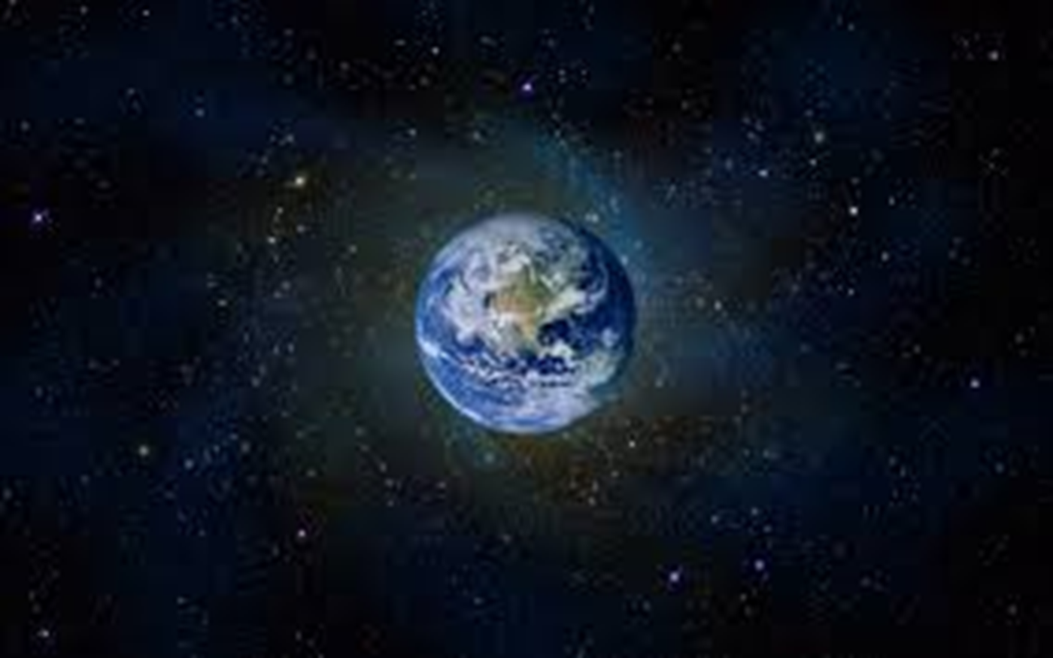
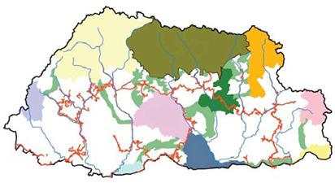
Welcome to the journey of GNH Happiness beyond GDP
Do we want our generations, yet to come…our grand children, their grand children and their grand children….to be happy? If yes, how can we unburden them from debt we have created and are still creating for them?

Slide 4
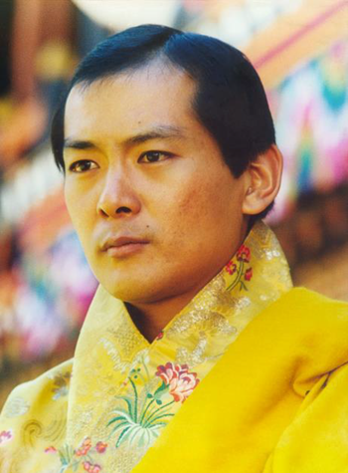
ORIGIN OF GNH Happiness
Gross National Happiness is more important than Gross National Product” - HM King Jigme Singye Wangchuck
1629: (1616 - Zhabdrung Nawang Namgyel - Bhutan’s legal code of states that if the government cannot create happiness and peace for its people, then there is no purpose for government to exist.)
1970s : Birth of GNH “ Gross National Happiness is more important than Gross National Product” HM King JSW
1998: UN Regional Summit, Seoul
2007 : GNH emerged as a philosophy for government policies and development – Keystone is Index
2011 Sept: GNH spoken at the {UNGA 2-4 April 2012 UN HQs (800 participants)}
2012: Res 66/281 on 29 June - 20 March as an International Day of Happiness and Res 65/309 on 6 Nov - Happiness: towards a holistic approach to development
2012 Aug: Conference in Thimphu – WHR 2012
2015: New Dev Paradigm Report submission to UN SG (Sept 2014 & the final in Feb 2015) for post millennium dev goals - SDGs
Notes:
Simple show

Slide 5
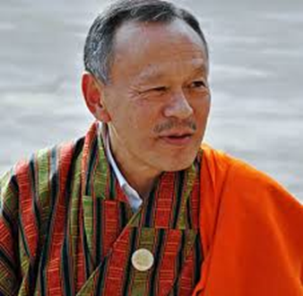
Definition of GNH Happiness
“We have now clearly distinguished the ‘happiness’ … in GNH from the fleeting, pleasurable ‘feel good’ moods so often associated with that term. We know that true abiding happiness cannot exist while others suffer, and comes only from serving others, living in harmony with nature, and realizing our innate wisdom and the true and brilliant nature of our own minds” – Former PM Hon Jigmi Y Thinley

Slide 6
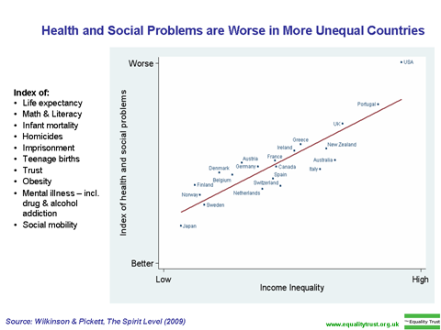
Does wealth bring happiness?
U.S. one of richest economies but ranks only 17th in reported life satisfaction behind much poorer countries (Costa Rica, Dominican Republic)
Although GNP per capita has tripled since 1960 in the US, life satisfaction remains unchanged but social inequalities have widened, social trust declining
What matters more? Community trust, relationship, good governance, meaningful & secure work, work/life balance…..

Slide 7
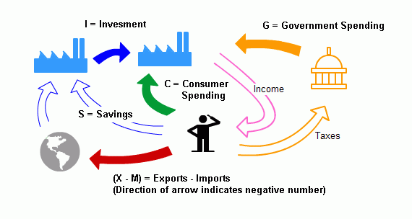
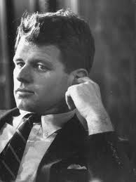
Economic Development must serve a Purpose for all living beings
The dogma of economic growth ignores ecological and social benefits. Many things that make GDP grow, and that are therefore conventionally counted as positive signs of an expanding economy, actually signify a decline in happiness and wellbeing.
GNP counts everything – except which makes life worth living
Y = C + I + E + G
Notes:
Environment destruction, love has no place, sitting here learning together has no value to GDP, working parents, drug and alcohol abuses, cigarette smoking, cutting trees from Bhutan….fossil fuel burning (tomato e.g.), etc.

Slide 8

WHAT IS HAPPINESS? – HRH PINCESS KEZANG CHODEN WHANGCHUCK
Happiness is the highest quality of life and contentment that every citizen must be able to enjoy in a truly civilized and flourishing society.
Genuine happiness is a sustained state of highest level of human wellbeing. It arises from a balanced pursuit and fulfillment of the dual needs of the human mind and body.

Slide 9
Preliminary Questions in GNH Happiness
Is happiness something one can measure?
Is the pursuit of happiness an individual or a collective matter?
Why the interest in GNH and Why now?
Why does the Bhutanese Government measure GNH happiness?
Why a new development paradigm beyond the GDP is utmost necessary now? Is it for happiness?

Slide 10
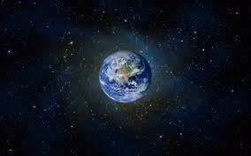
The Three Divides

Slide 11
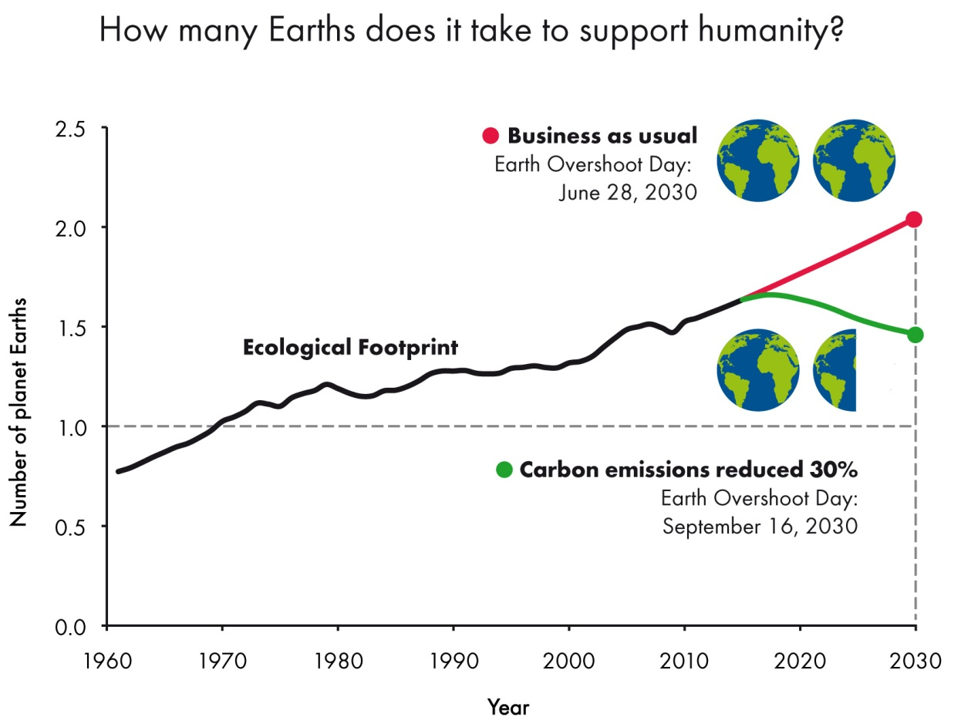
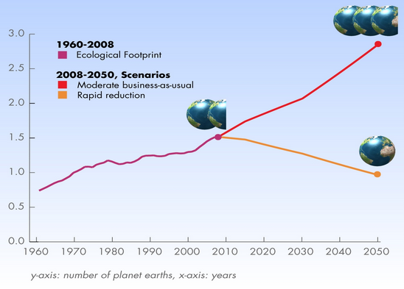
Borrowing from the future
Notes:
Global forest reduced to 3.7 billion ha from 4.13 billion ha between1990 and 2015, which is a 10% decrease. Philippines 298170 sq km (300,000) 35% in 1990 to 25.7% in 2014
Aquatic life is rapidly dying…(e.g. Philippines uncontrolled deforestation especially in watershed areas; soil erosion; air and water pollution in major urban centers; coral reef degradation; increasing pollution of coastal mangrove swamps that are important fish breeding grounds)
Bhutan increased its forest land cover from 60% to 80% -
Rain forest in Malaysia is almost destroyed, remains in Congo and amazon (Brazilian Rainforest 2600+ ha brought growing animal feed)
Jack Ma – bought 28K forest in central America
394 avg. disasters PY (2002 and 2011 – with av. 268 m victims of disaster) –down to 237 disasters in 2012 with only 124.5 m victims worldwide
CFC -

Slide 12
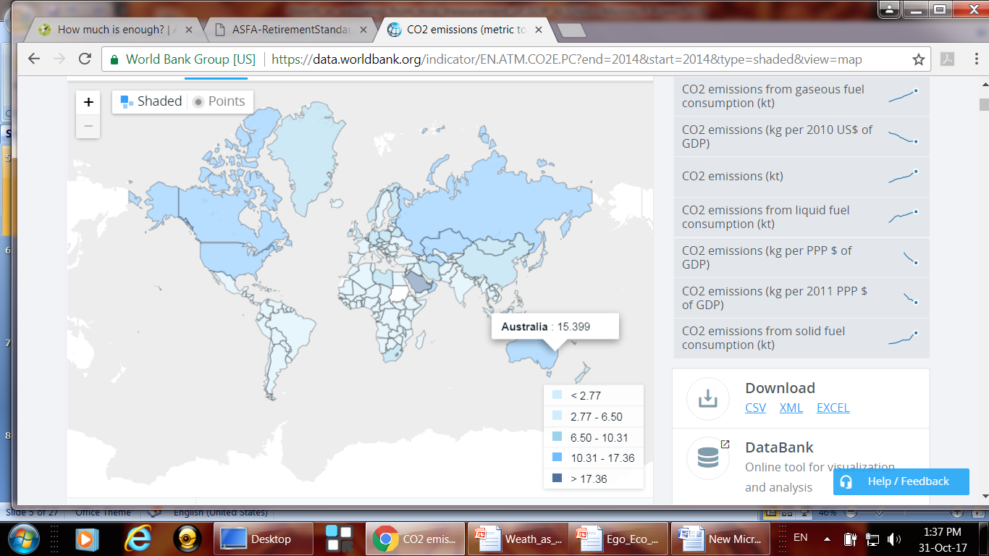
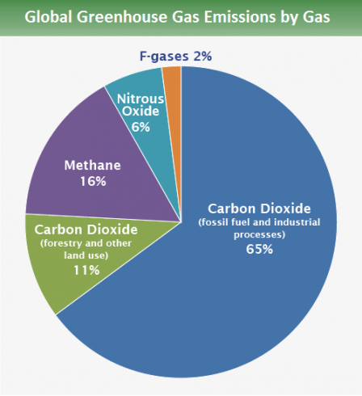
Carbon emission in the world
5%
EU 9%
15%
30%
4%
7%
Source: IPCC, 2014 Global GHGs
WB, Oct 2017
Notes:
On average = about 5 tones per person as of 2014.

Slide 13
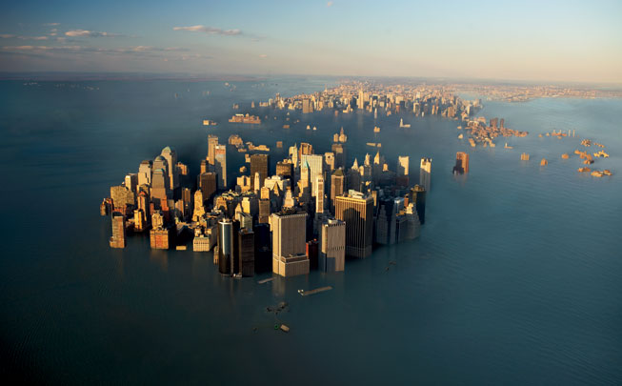
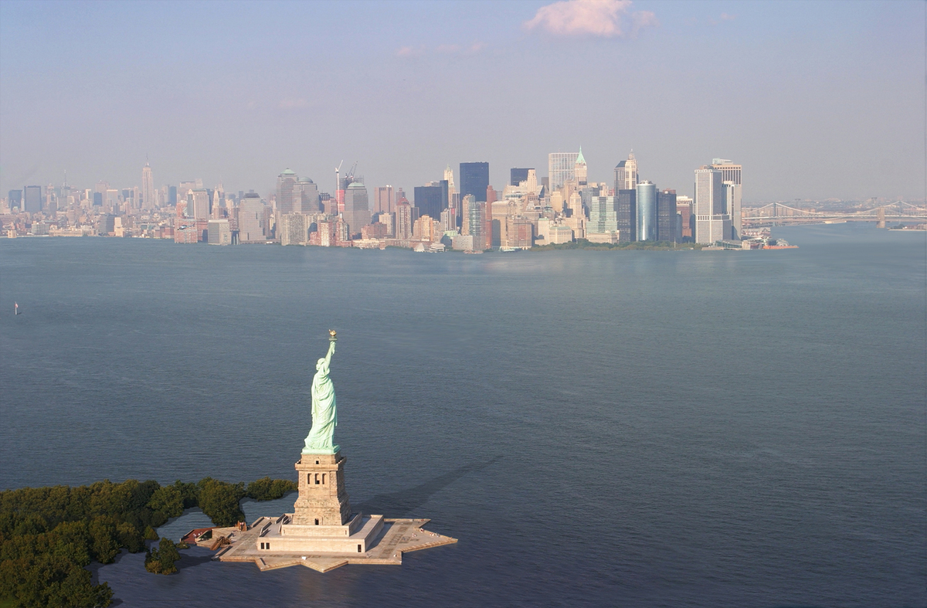
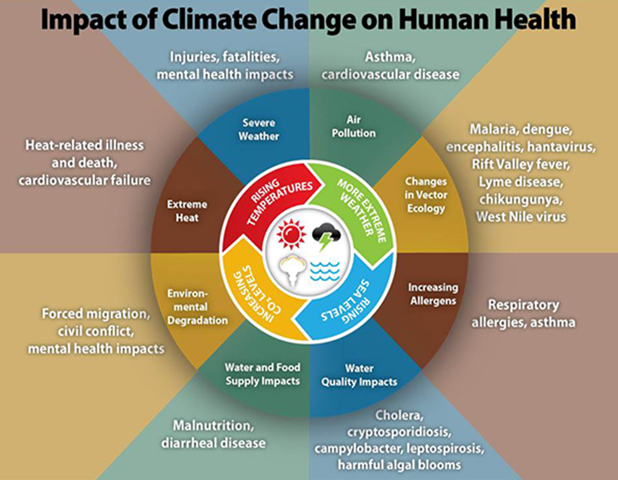
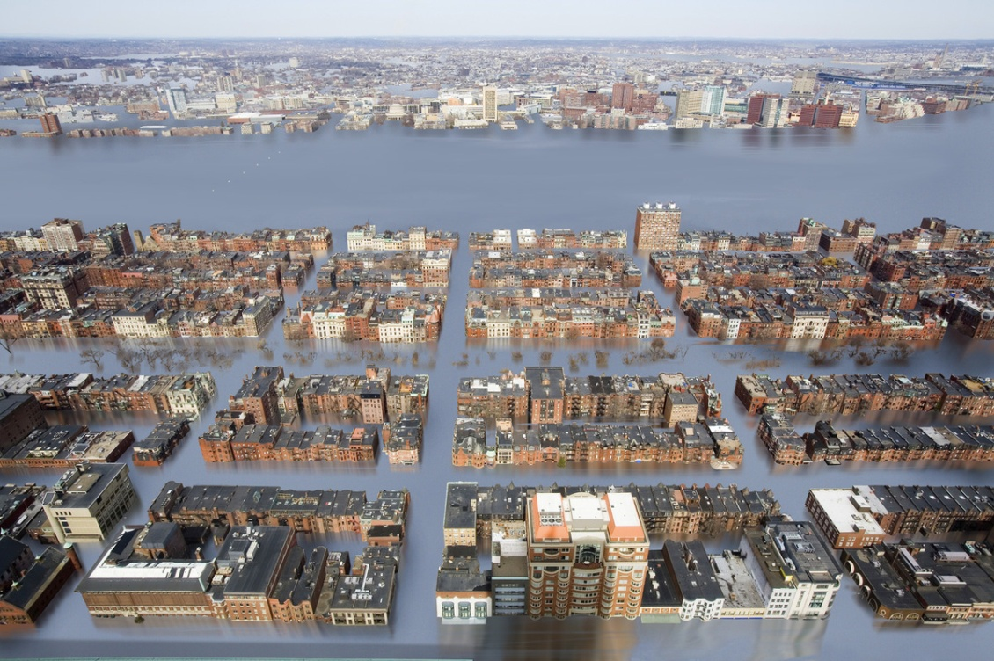
Effects of Global Warming
Business as usual causes water level to rise by 2070-2100

Slide 14
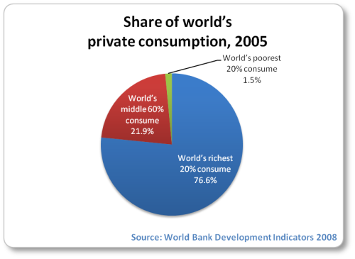
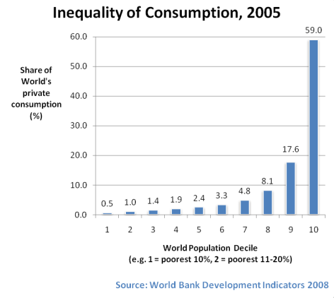
Economic crises income & consumption
60% take 20% GI
World’s poorest 20% take less than 5 % of global income
World’s richest 20%, take away 75% of global income
Every year 15 million people die from hunger & hunger related diseases (incl. one child every five seconds) – 795 million are undernourished
1.4 billion people in extreme poverty in 2005 to 836 million in 2015 (800 million earn below 1.25$ a day).
1 billion have no drinking water (40% global population have water scarcity due to climate change).

Slide 15
What is enough?
Modest lifestyle Comfortable lifestyle
Single Couple Single Couple
$23,878 $35,369 $39,443 $55,382
For retired persons in Australia – ASFA June Q 2017 (Figures in total Aus $ per Year)
US/UK: Princeton University 2010 = Avg USD 75,000 (place dependent, begins at 30K)
India : low-MC 16-18K, mid-MC 30-40K, upper-MC40-60K and Cities:40-100K (city dependent)

Slide 16
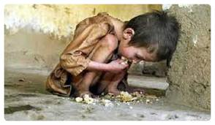
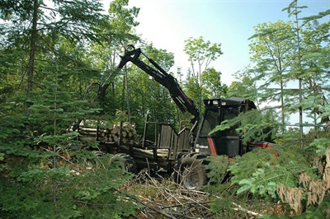
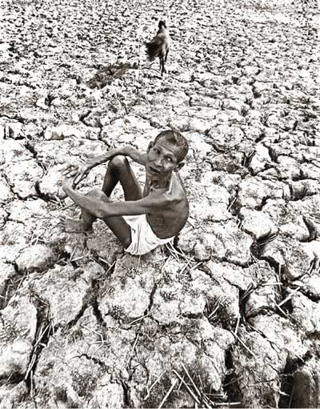
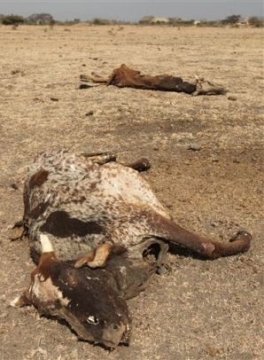
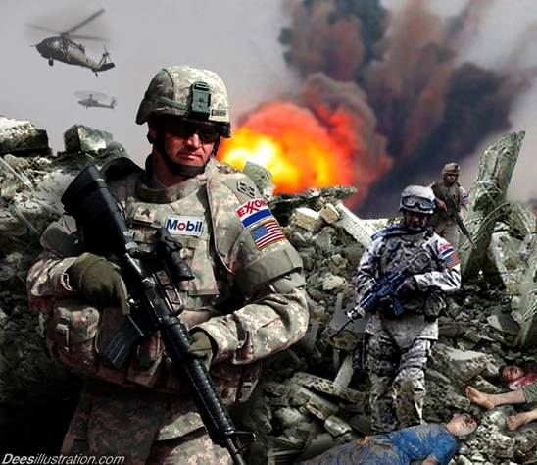
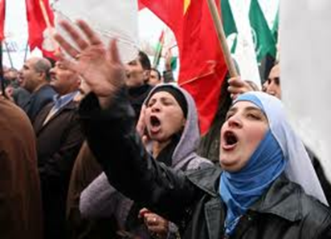
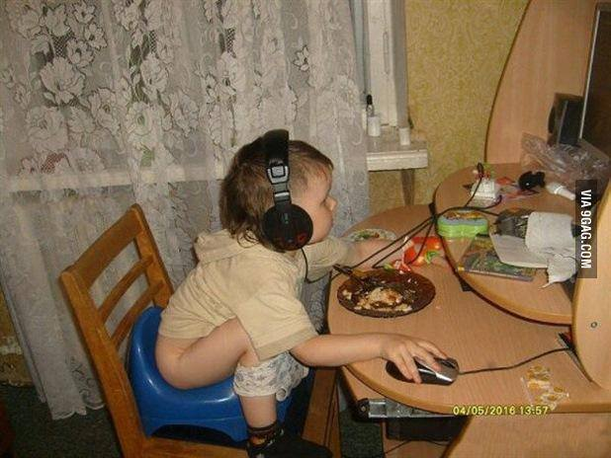
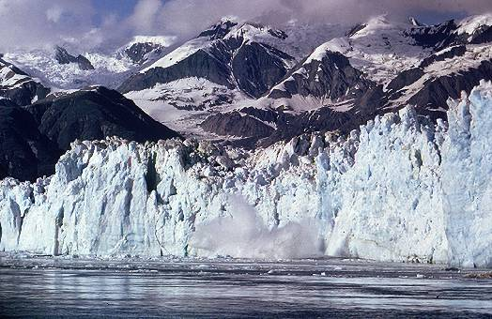

Lack of leadership: A socio-economic divide

Slide 17
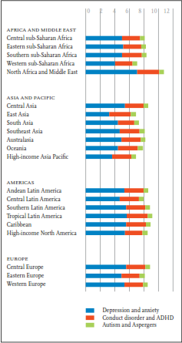
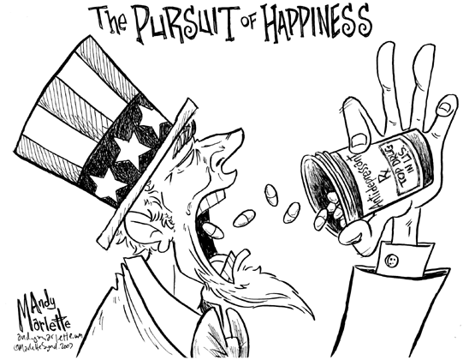
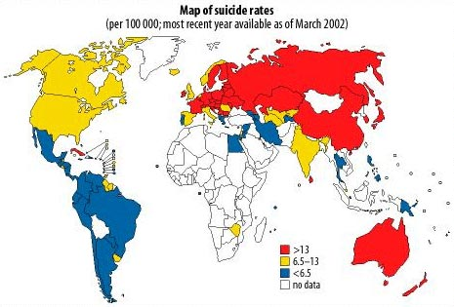
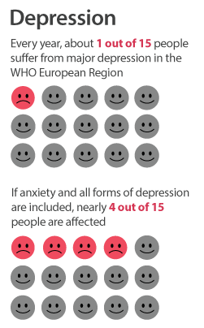



Mental disorder among children under 19 years of age is huge, almost 8% of GP
SOCIAL DIVIDE
400% of antidepressant drug prescription in the US in the last decade
9.2 million of world population divorces each year
64 million crimes each year
12% of world pp is mentally sick
ADHD/ADD is catching up
Autism is on the rapid increase

Slide 18
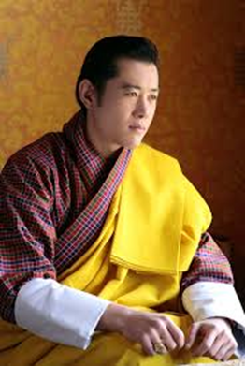
Significance of GNH
GNH has come to mean so many things to so many people but to me it signifies simply - Development with Values. Thus for my nation today GNH is the bridge between the fundamental values of kindness, equality and humanity. - The King His Majesty Jigme Khesar Namgyel Wangchuck
Notes:
values= wisdom, moral, and mindfulness
Wisdom = right thought and understanding
Moral = right speech, right action, and right livelihood
Mindfulness = right meditation, right efforts, and right concentration

Slide 19
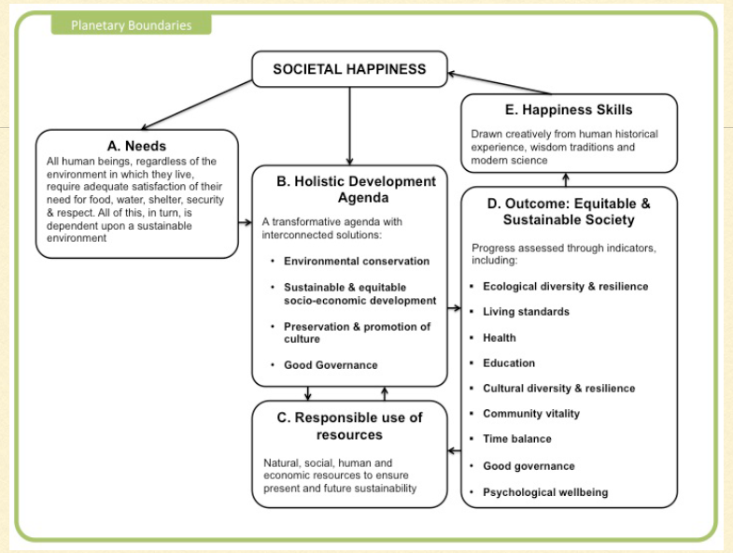
Notes:
Societal happiness as a measure within planetary boundaries, need based and not need base economy and sustainability

Slide 20
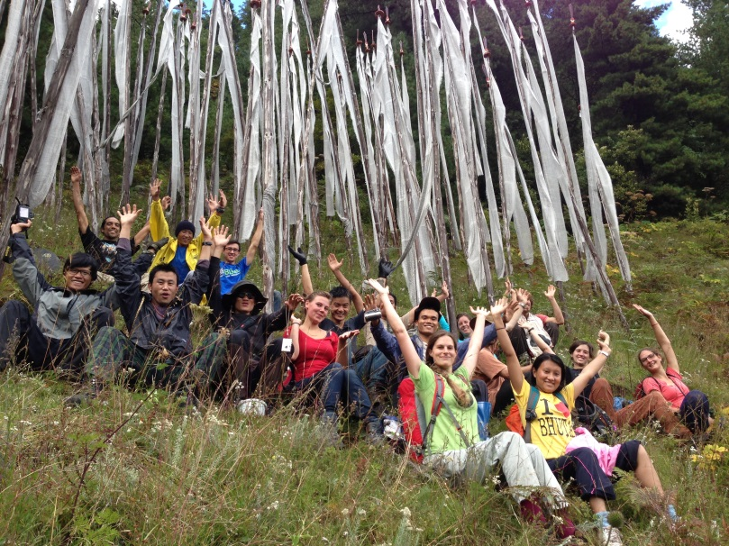
Premise of GNH
Holistic: Recognizing all the aspects of people’s needs, be these spiritual or material, physical or social
Balanced: Emphasizing balanced progress towards the attributes of GNH
Collective: Viewing happiness
to be an all-encompassing collective phenomenon
Sustainable: Pursuing wellbeing for both current and future generations
Equitable: Achieving reasonable and equitable distributed level of wellbeing

Slide 21
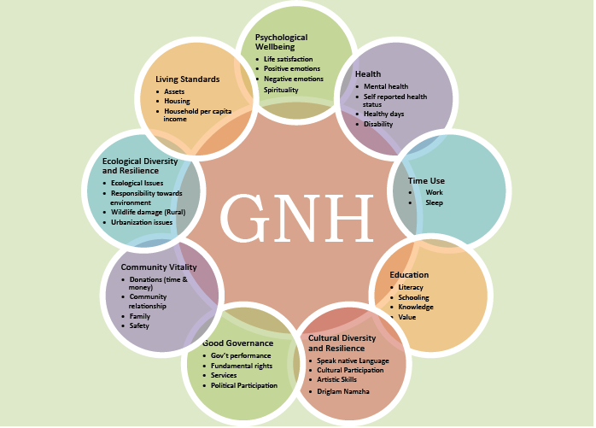
2.Environment Preservation
1. Sustainable & Equitable Socio-economic development
4. Good Governance
3. Promotion & Preservation of culture
Notes:
Time Use
28.5 years sleeping, 10 years earnings, 9 years house chorus, 6 years education and grooming, 9 years social media, 2 years for community and stuck in traffic jam, 2 years shopping, 1.5 years child raising, 4 years eating and drinking – left anything between 5-9 years….What do we do during this time…
Education
20 % of world population is illiterate (how can we help?)
Bhutan 73% literacy rate (non-formal education)
Education for all (standard 10 – higher studies!!)
GNH in Education (language in usage)
Education production (I, me & mine – shrewd, competitive, selfish....my schooling experience)
Vocation and academics
Culture
Lost culture (e.g. empty Churches on Sundays in most of places on earth)
Natural cooperation – also reducing festivities
We sing songs in praise of our Kings (Swazi)
Respecting the nature – taking permission
Oral story telling
Identity crises
Community
Community Relationship (e.g. neighbours are not known to each other).
Cost to government for a few of community vitality is Nu 431 million (2012).
Generosity / donations.
Cultural participation (invitation for festivities in the west and info in Bhutan).
Walk in to a home....
Living Standard
The world
Over 1 billion people under poverty
3 billion have drinking water shortages and 1 billion without
Gap between rich and poor (America, south Africa)
Bhutan
Gini-coefficient 30.5-increased by 0.1 % in 30 years
Poverty is 12 % in Bhutan (defined by income)
Six promised of the first democratic govt. roads, telecommunication, lights, water, education and health (poverty down from 25% to 12%)

Slide 22
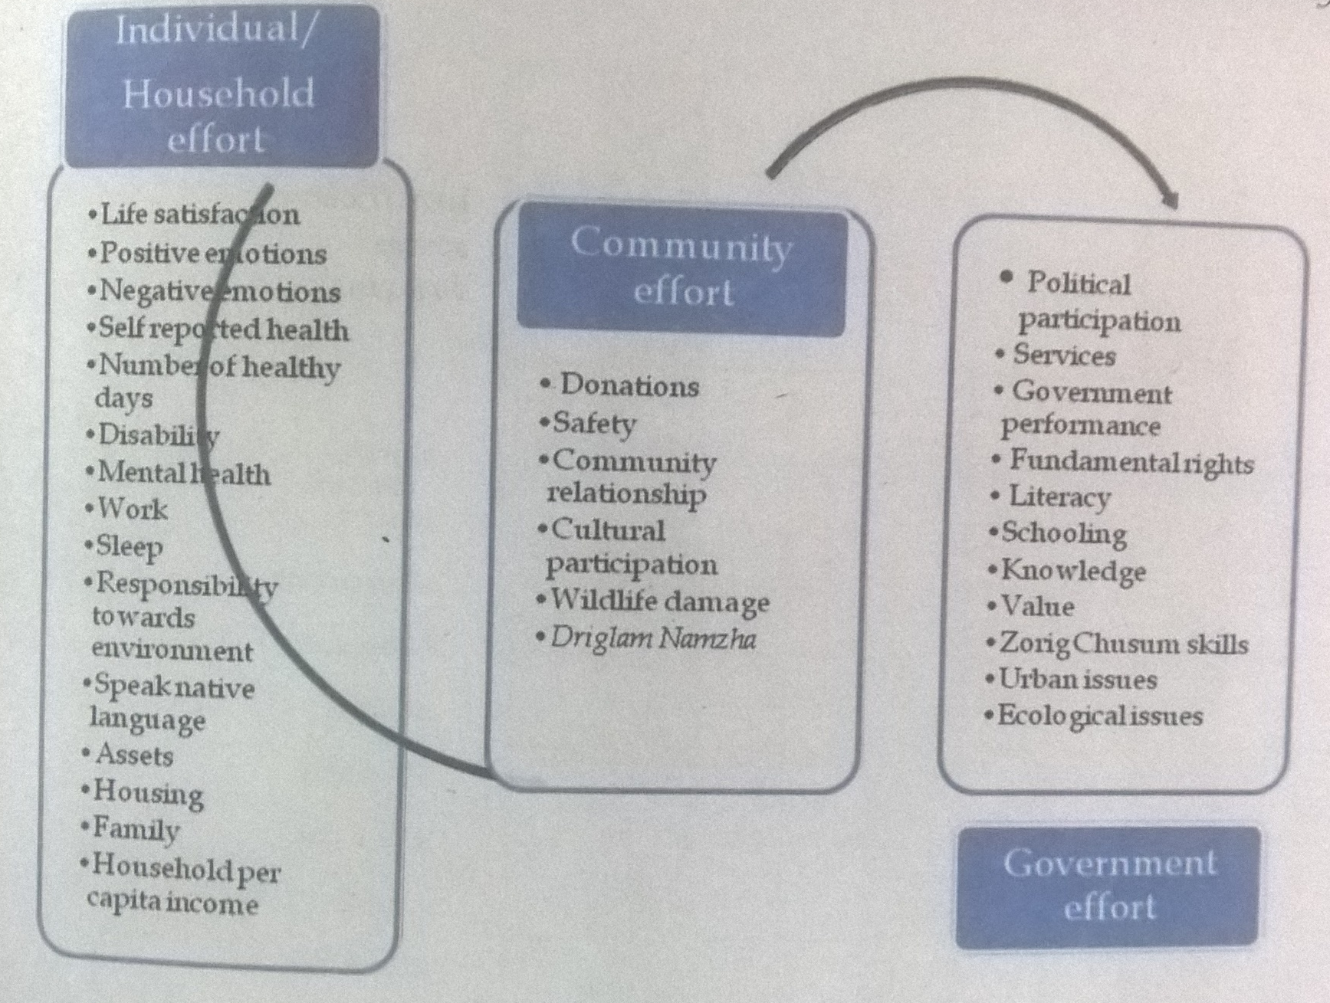
Overlapping responsibilities for increasing happiness
16
6
11

Slide 23
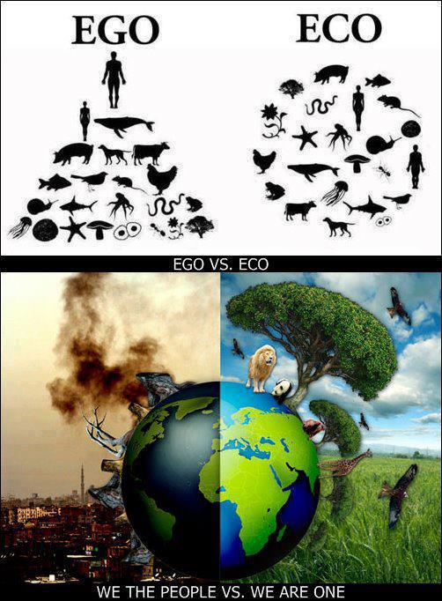
Cessation of the Divides brings us to timeless beauty of the world
Practice mindfulness (incl. contemplation & reflection for an inner journey)
Connect with human values & serve others
Build love as foundation of living in harmony with nature.
→ From Ego to Eco = connection with Interdependence
GDP
GNH

Slide 24
Tashi Delek Zhu!
Happiness is here and now, I have dropped my worries, nowhere to go, nothing to do, and I am not in a hurry.
Happiness is here and now, I have dropped my worries, somewhere to go, something to do, but I am not in a hurry.
May you be well and happy always
May you find happiness in what you do
May you bring happiness to the lives you touch
May you be the northern star for yourself, family, friends, society and the world.

